Slide 1
NeRF
虞煌杰
2020-09-27

Slide 2
Preview on Light Fields
The eldest Light Field
Rendering:
Nearest
Linear
Bilinear
…
Characteristics
Only calibrated images
No explicit geometry
Problem
Strong ghosting effect

Slide 3
Aliasing Artifacts

Slide 4
Lumigraph
Lumigraph
Characteristics
Calibrated images
Geometry proxy (not accurate)
Render
Use depth to guide interpolation

Slide 5
View-Dependent Texture Mapping
“The Scene”
View-Dependent Texture Mapping
Characteristics
Calibrated images
Geometry (accurate)
Render
Search for nearest samples
Interpolate using angle differences
Desired Camera

Slide 6
Unstructured Lumigraph
“The Scene”
Unstructured Lumigraph
Characteristics
Calibrated images
Geometry (accurate)
Render
Search for nearest samples
Calculate penalties
Interpolate using penalties
Desired Camera

Slide 7
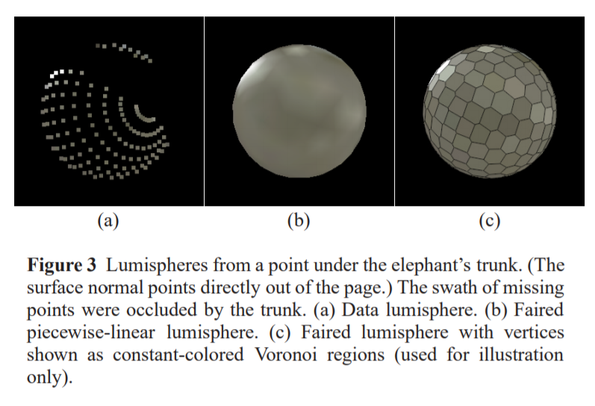
Surface Light Field
Surface Light Field
Characteristics
Calibrated images
Geometry (accurate)
Render
Construct a continuous Lumisphere function for each vertex
Render by sampling Lumisphere

Slide 8
Preview on Light Fields
Summary
Light Field
No geometry
Hard to render correctly
Lumigraph or VDTM or ULG or S-LF
Need explicit geometry
Easy to render correctly

Slide 9
Preview on Light Fields
A natural question:
Is it possible to render without geometry while maintain appealing visual quality?
A recent work gives answers to this question

Slide 10
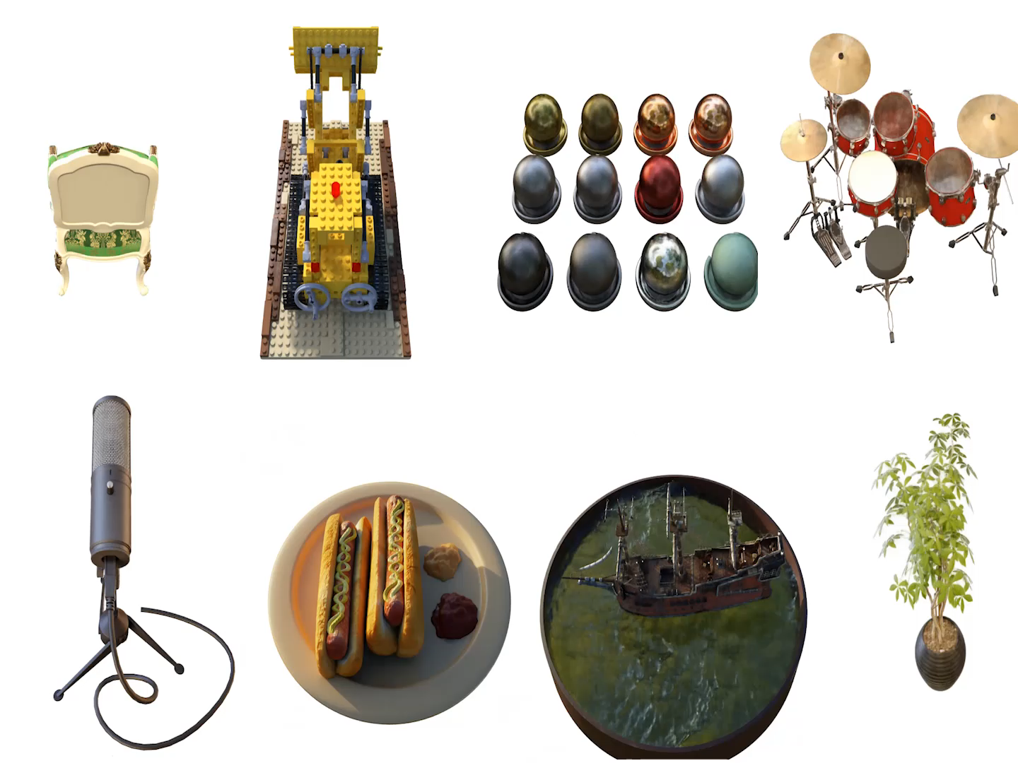
Overview of NeRF
Free Viewpoint Video

Slide 11
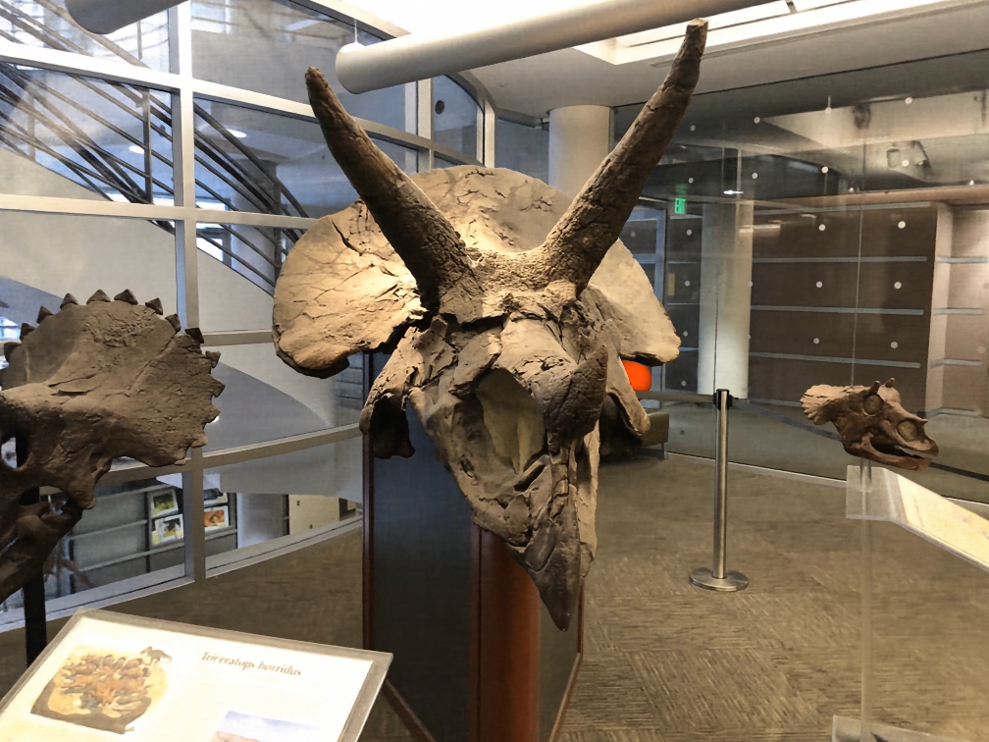
Overview of NeRF
Extract iso-surface (MR)

Slide 12
NeRF - Characteristics
Input
Calibration Images
No geometry needed !
Output – Free Viewpoint Video
Think of it as relaxed Unstructured Lumigraph !

Slide 13
NeRF - Characteristics
“The Scene”
Desired Camera

Slide 14
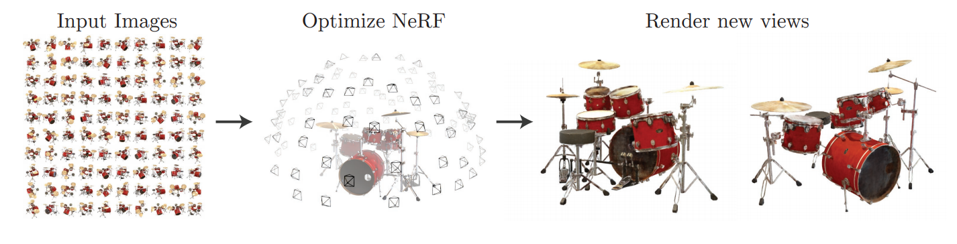
NeRF - Characteristics

Slide 15
Overview of NeRF
Q2: Name three technologies that NeRF used?
A: 1. Multi-Layer Perceptron (Deep Learning)
2. Volume Rendering
3. Positional Encoding

Slide 16
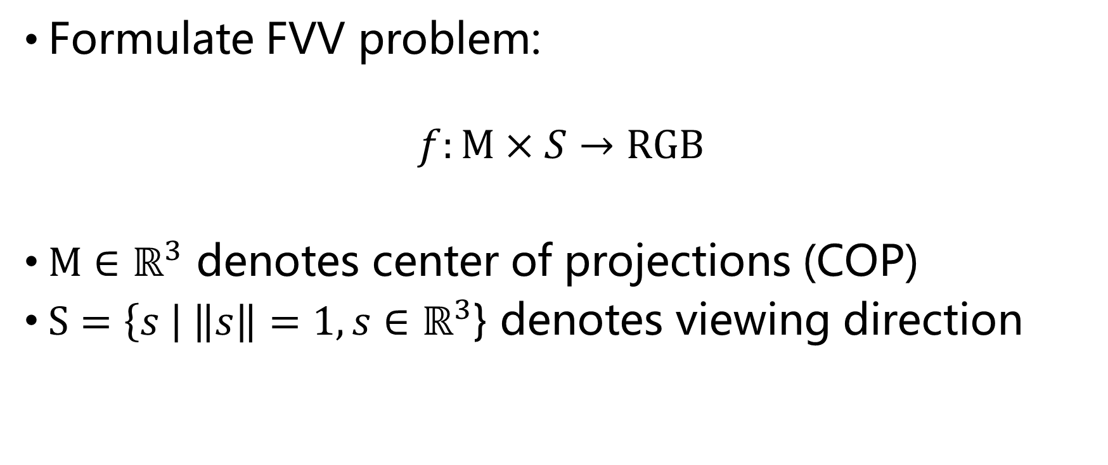
MLP – first part
Formulate FVV problem:
$$f:M×S→RGB$$
$M∈ℝ^{3}$ denotes center of projections (COP)
$S=\left\{s \right| \left\|s\right\|=1,s∈ℝ^{3}$} denotes viewing direction

Slide 17
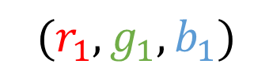



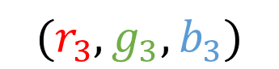
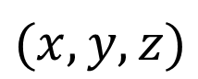
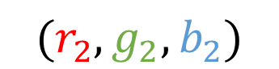
MLP – first part
A simple example:
$$(dx_{1}, dy_{1}, dz_{1})$$
$$(r_{1}, g_{1}, b_{1})$$
$$(dx_{2}, dy_{2}, dz_{2})$$
$$(r_{2}, g_{2}, b_{2})$$
$$(dx_{3}, dy_{3}, dz_{3})$$
$$(r_{3}, g_{3}, b_{3})$$
$$(x,y,z)$$

Slide 18
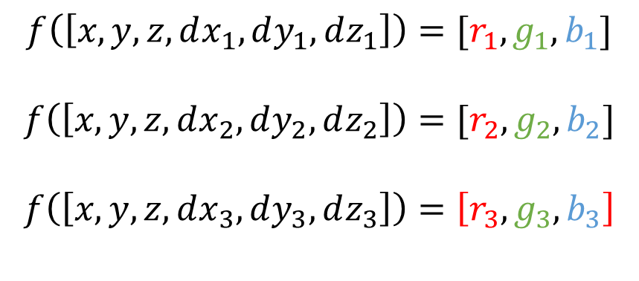

MLP – first part
A simple example:
$$f\left(\left[x,y,z,dx_{1},dy_{1},dz_{1}\right]\right)=[r_{1}, g_{1}, b_{1}]$$
$$f\left(\left[x,y,z,dx_{2},dy_{2},dz_{2}\right]\right)=[r_{2}, g_{2}, b_{2}]$$
$$f\left(\left[x,y,z,dx_{3},dy_{3},dz_{3}\right]\right)=\left[r_{3}, g_{3}, b_{3}\right]$$
……
Total $N∗W∗H$ mappings

Slide 19
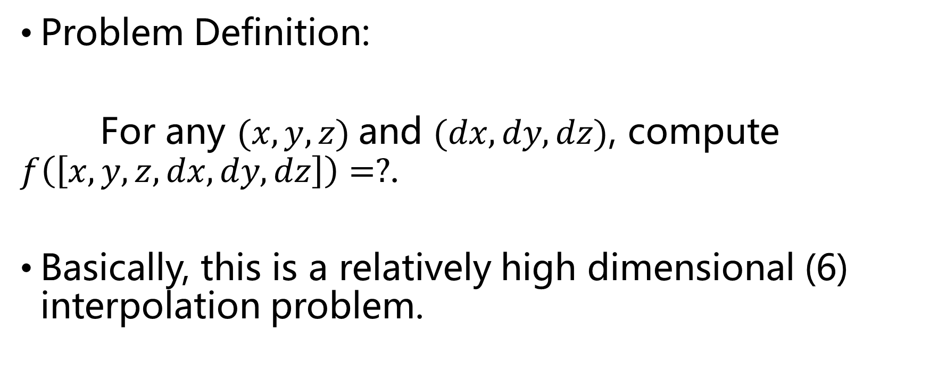
MLP – first part
Problem Definition:
For any $(x,y,z)$and $(dx, dy, dz)$, compute $f\left(\left[x,y,z,dx,dy,dz\right]\right)=?$.
Basically, this is a relatively high dimensional (6) interpolation problem.

Slide 20
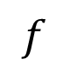
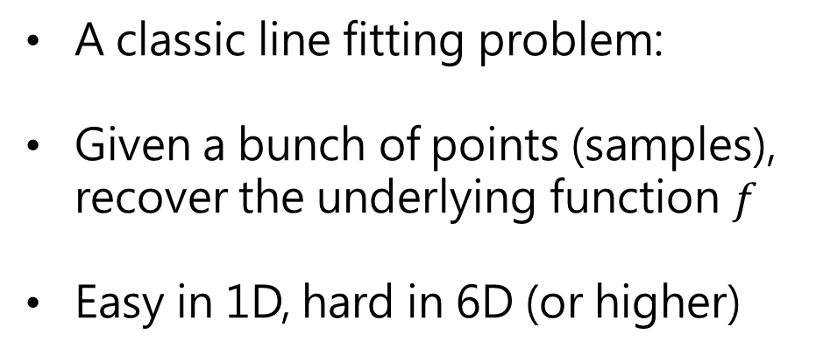
MLP – first part
samples
y
A classic line fitting problem:
Given a bunch of points (samples), recover the underlying function $f$
Easy in 1D, hard in 6D (or higher)
$$f$$
x

Slide 21
MLP – first part
High dimensional interpolation (regression) is where machine learning steps in
Neural Networks:
MLP (classic artificial network)
CNN (image understanding)
RNN (speech recognition)
…
More on the book “Deep Learning”by Ian Goodfellow

Slide 22
MLP – first part
The Uniform Approximation Theorem:
A continuous function can be approximated by a network of one or more layers arbitrarily well.
Not very helpful…

Slide 23
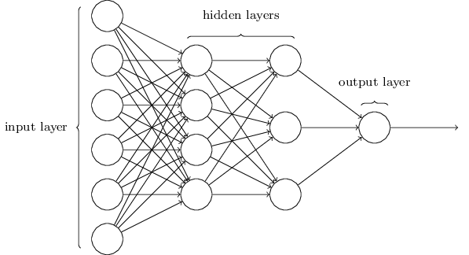
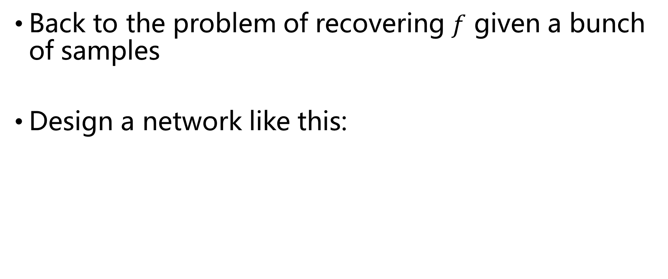
MLP – first part
Back to the problem of recovering $f$ given a bunch of samples
Design a network like this:
x
y
z
R
dx
G
dy
dz
B

Slide 24
MLP – first part
It simply won’t give meaningful results
Why?

Slide 25
MLP – first part
“The Scene”
Cameras are sparsely distributed

Slide 26
MLP – first part
y
y
x
x
Easy task
Impossible task

Slide 27
MLP – first part
Q: How to do better?
A: If COP is too sparse, we sample dense points along a ray. The resulting training base is huge.

Slide 28

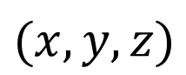
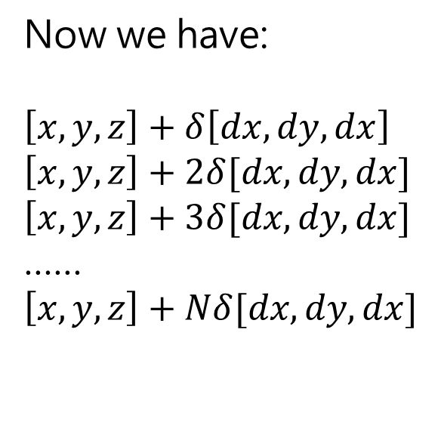
MLP – first part
$$(dx, dy, dz)$$
Uniform sample
Importance sample
……
Now we have:
$$\left[x,y,z\right]+δ\left[dx,dy,dx\right]$$
$$\left[x,y,z\right]+2δ[dx,dy,dx]$$
$$\left[x,y,z\right]+3δ[dx,dy,dx]$$
……
$$\left[x,y,z\right]+Nδ[dx,dy,dx]$$
$$(x,y,z)$$

Slide 29
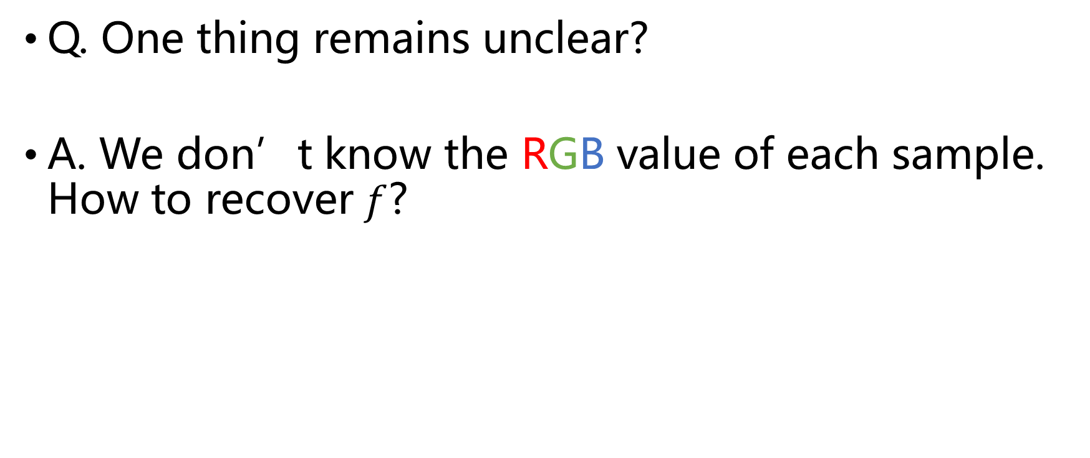
MLP – first part
Q. One thing remains unclear?
A. We don’t know the RGB value of each sample. How to recover $f$?

Slide 30
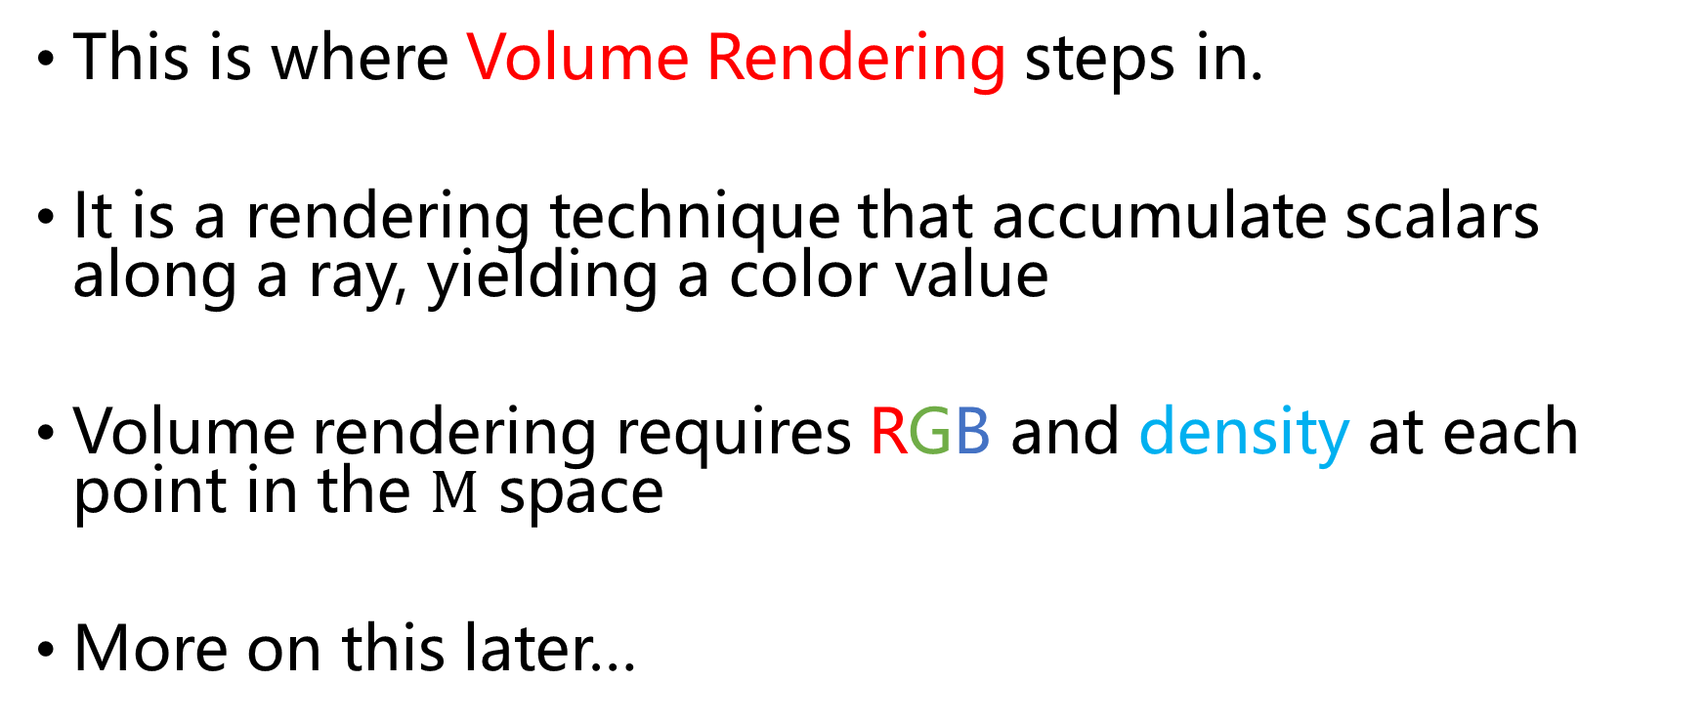
MLP – first part
This is where Volume Rendering steps in.
It is a rendering technique that accumulate scalars along a ray, yielding a color value
Volume rendering requires RGB and density at each point in the $M$ space
More on this later…

Slide 31
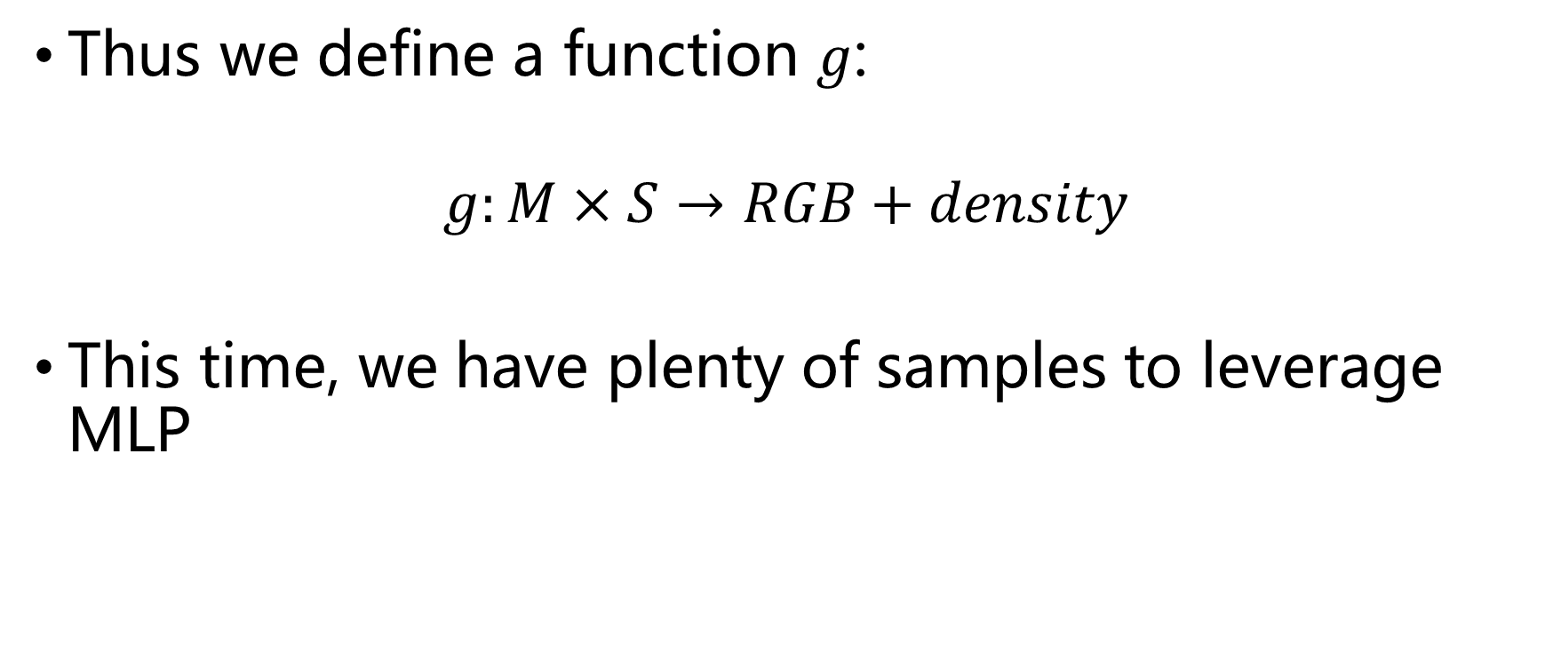
MLP – first part
Thus we define a function $g$:
$$g:M×S→RGB+density$$
This time, we have plenty of samples to leverage MLP

Slide 32
MLP – first part

Slide 33

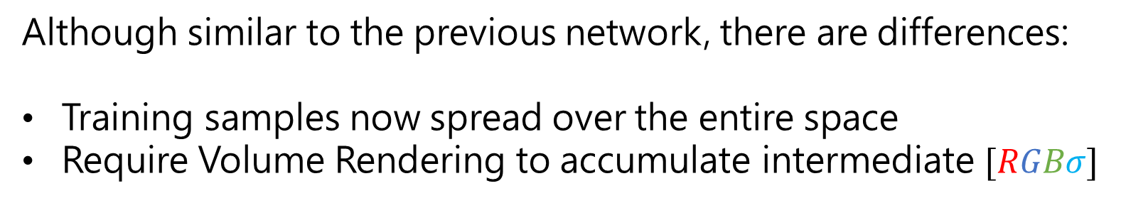
MLP – first part
x
$$σ$$
y
z
R
dx
G
dy
dz
B
Although similar to the previous network, there are differences:
Training samples now spread over the entire space
Require Volume Rendering to accumulate intermediate $[RGBσ]$

Slide 34
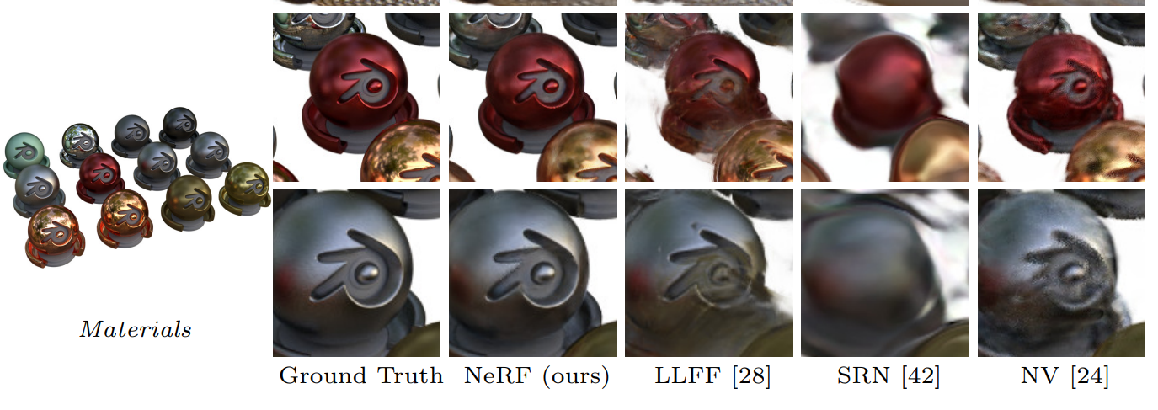
MLP – first part

Slide 35
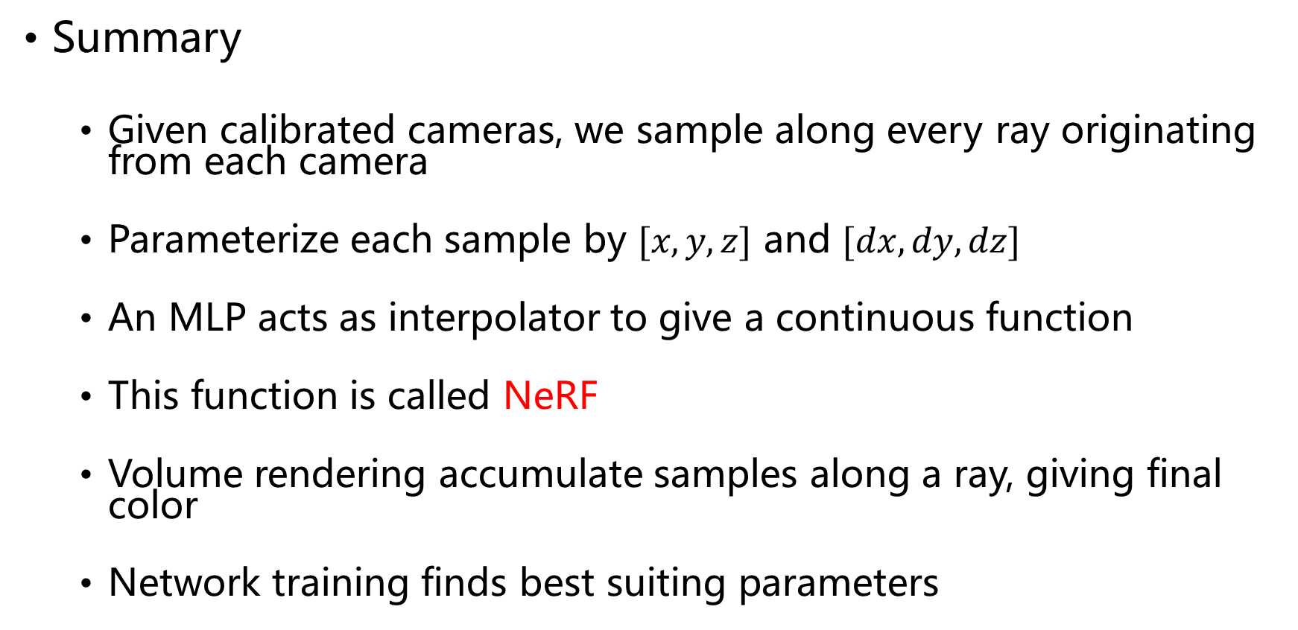
MLP – first part
Summary
Given calibrated cameras, we sample along every ray originating from each camera
Parameterize each sample by $[x,y,z]$ and $[dx,dy,dz]$
An MLP acts as interpolator to give a continuous function
This function is called NeRF
Volume rendering accumulate samples along a ray, giving final color
Network training finds best suiting parameters

Slide 36
Direct Volume Rendering
Q: What is volume rendering?
A: A technique to visualize 3D scalar field, giving a 2D image

Slide 37
Direct Volume Rendering
Example (CT scan)
It has been found that body organs have reactions to X-ray
Measure X-ray penetration from different angles
Result in a 3D scalar field
Visualize different organs by tuning transfer functions

Slide 38
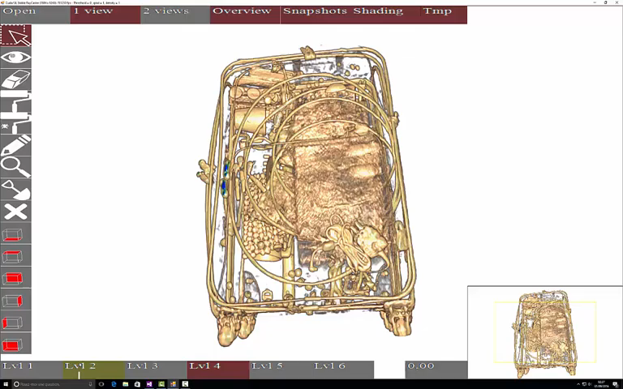
Direct Volume Rendering
Example (luggage scan)

Slide 39
Direct Volume Rendering
Optical models
Absorption
Emission
Scattering
One or more combined

Slide 40
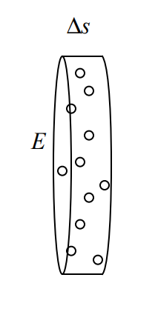
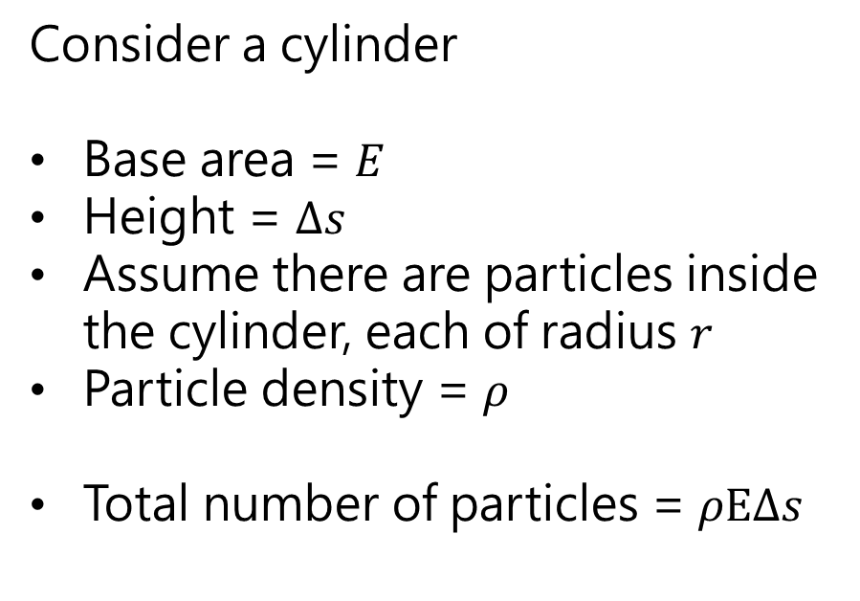
Absorption Only
Consider a cylinder
Base area = $E$
Height = $Δs$
Assume there are particles inside the cylinder, each of radius $r$
Particle density = $ρ$
Total number of particles = $ρEΔs$

Slide 41
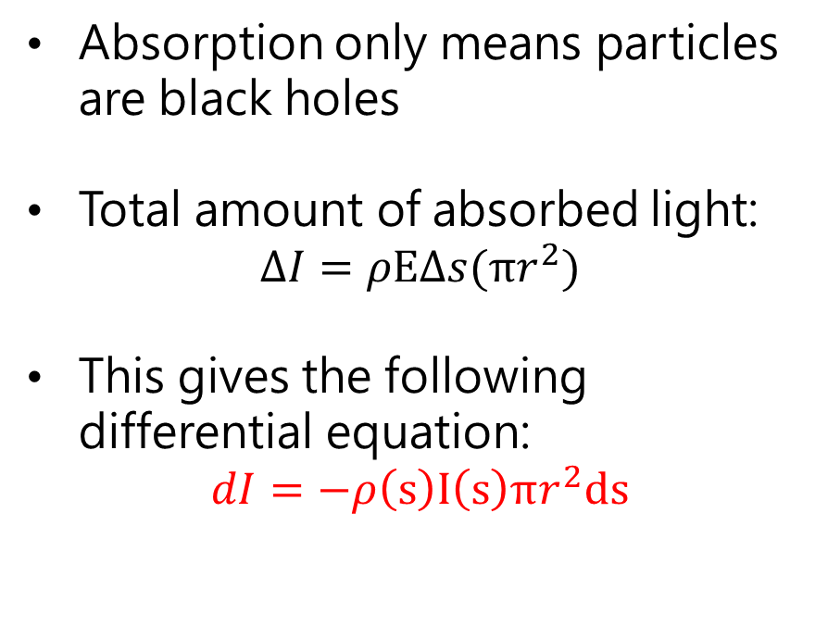
Absorption Only
Absorption only means particles are black holes
Total amount of absorbed light:
$$ΔI=ρEΔs(πr^{2})$$
This gives the following differential equation:
$$dI=−ρ\left(s\right)I\left(s\right)πr^{2}ds$$

Slide 42
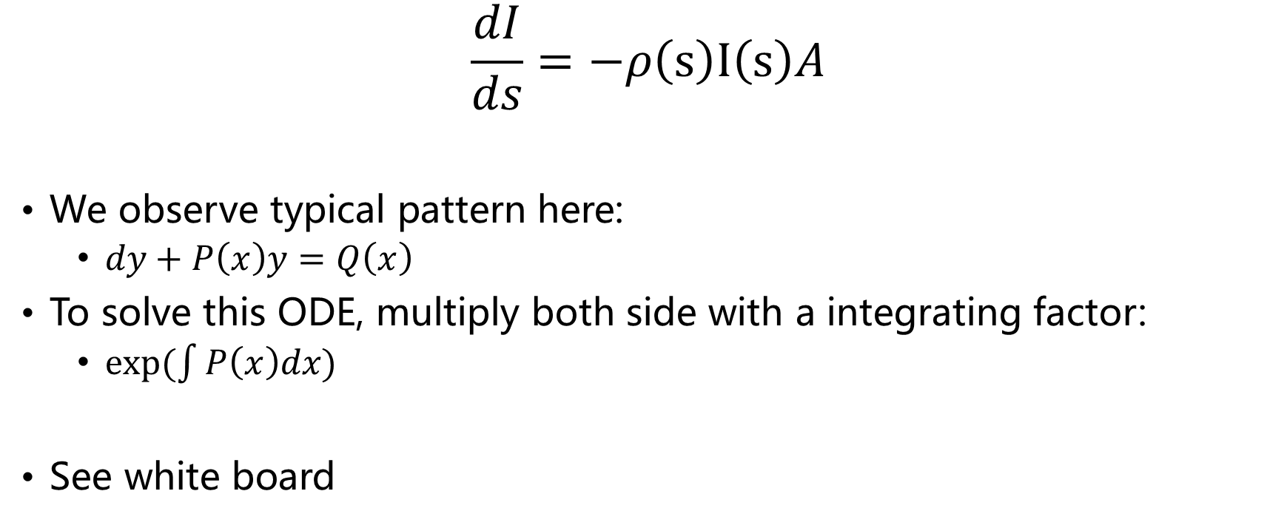
Absorption Only
$$\frac{dI}{ds}=−ρ\left(s\right)I\left(s\right)A$$
We observe typical pattern here:
$dy+P\left(x\right)y=Q\left(x\right)$
To solve this ODE, multiply both side with a integrating factor:
$exp⁡(\int{P\left(x\right)dx)}$
See white board

Slide 43
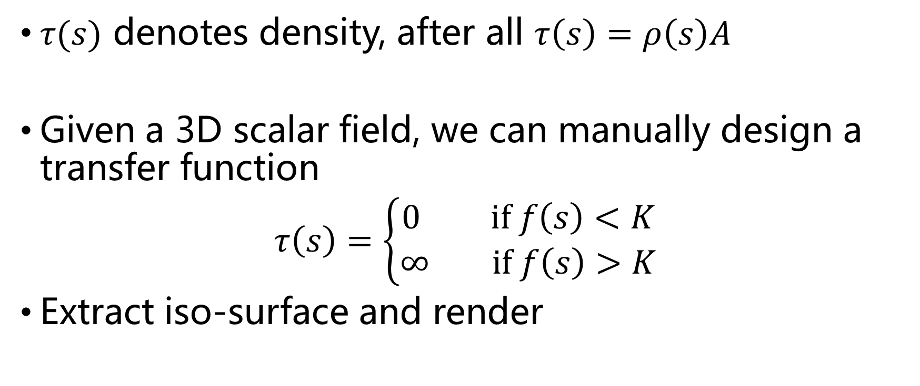
Absorption Only
$τ(s)$ denotes density, after all $τ\left(s\right)=ρ\left(s\right)A$
Given a 3D scalar field, we can manually design a transfer function
$τ\left(s\right)=\left\{\begin{aligned}0 if f\left(s\right)<K \\ ∞ if f\left(s\right)>K\end{aligned}\right.$
Extract iso-surface and render

Slide 44
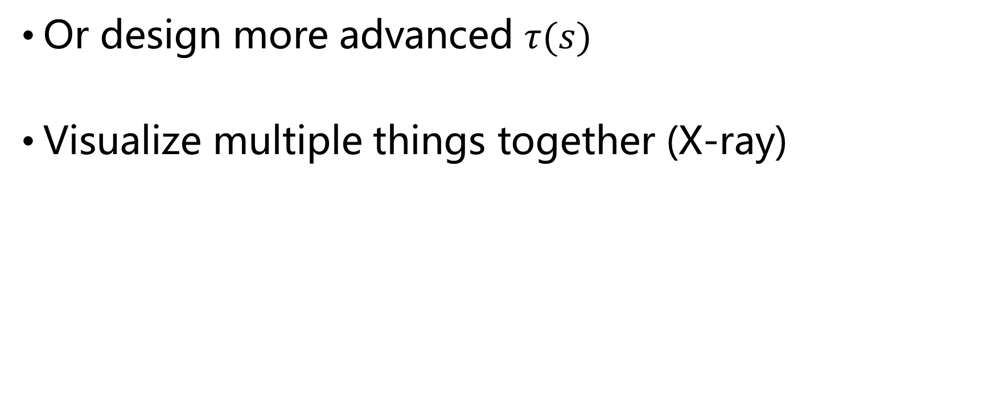
Absorption Only
Or design more advanced $τ(s)$
Visualize multiple things together (X-ray)

Slide 45
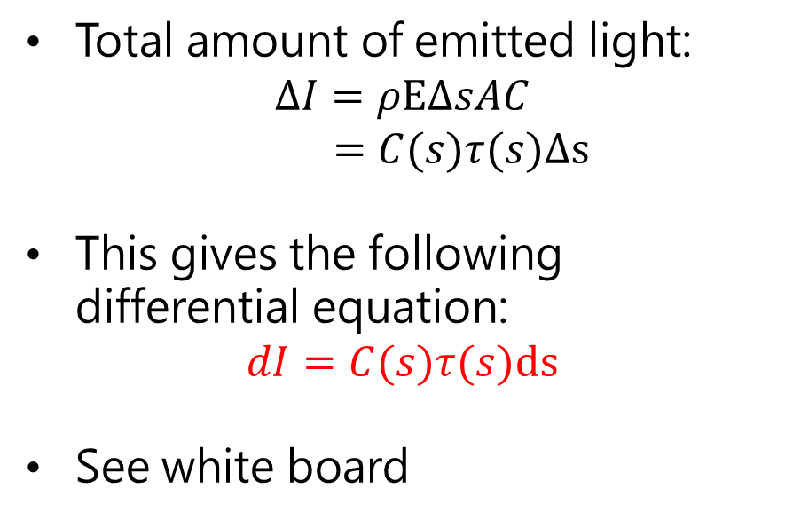
Emission Only
Similar to absorption, only particles emit light and don’t absorb light
Total amount of emitted light:
$$ΔI=ρEΔsAC$$
$$=C(s)τ(s)Δs$$
This gives the following differential equation:
$$dI=C(s)τ(s)ds$$
See white board

Slide 46
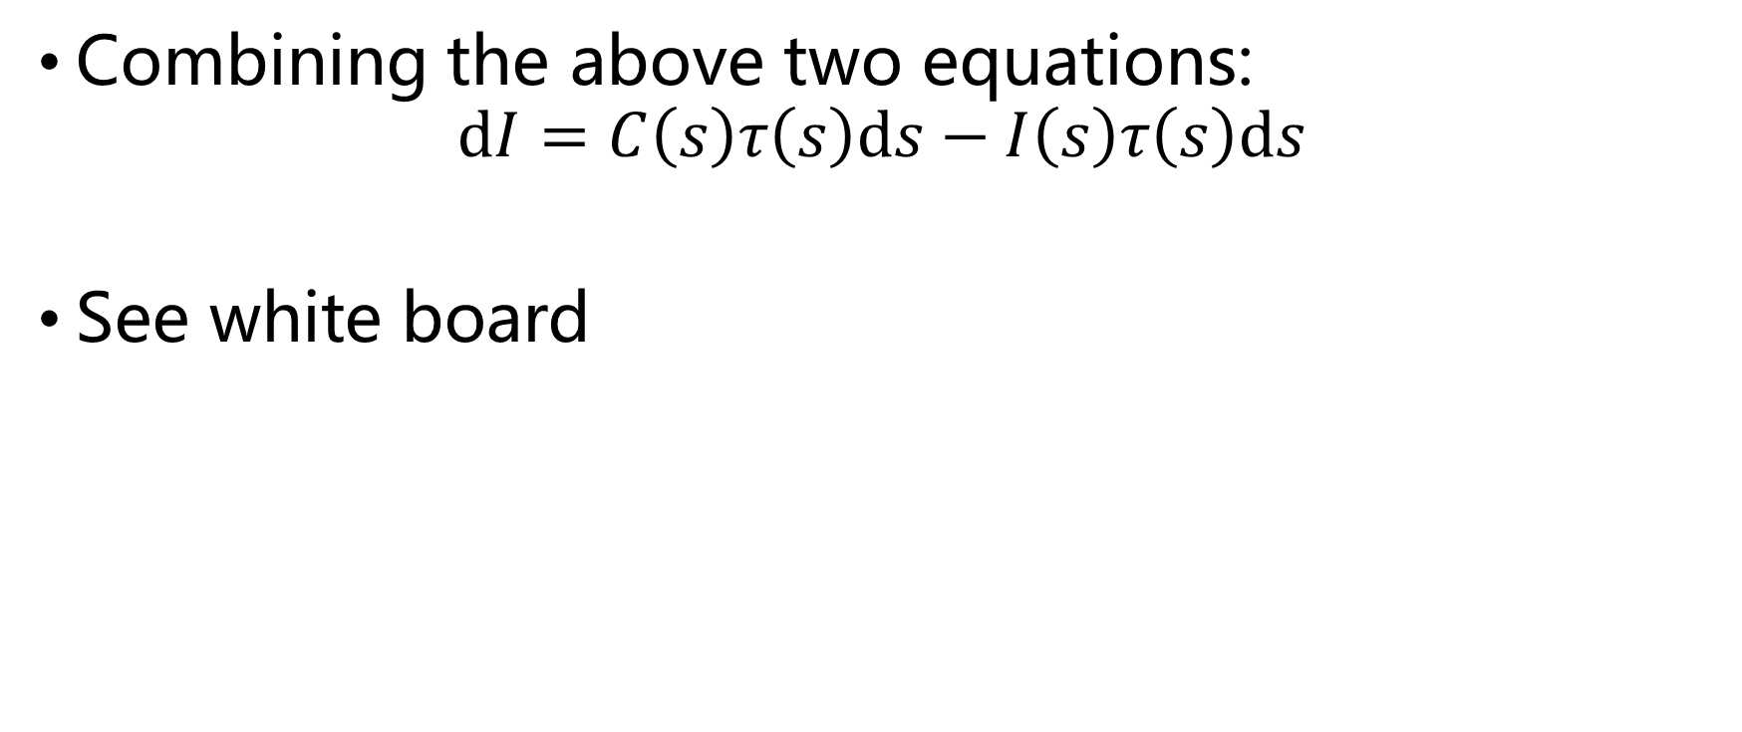
Absorption + Emission
Combining the above two equations:
$$dI=C\left(s\right)τ\left(s\right)ds−I\left(s\right)τ\left(s\right)ds$$
See white board

Slide 47
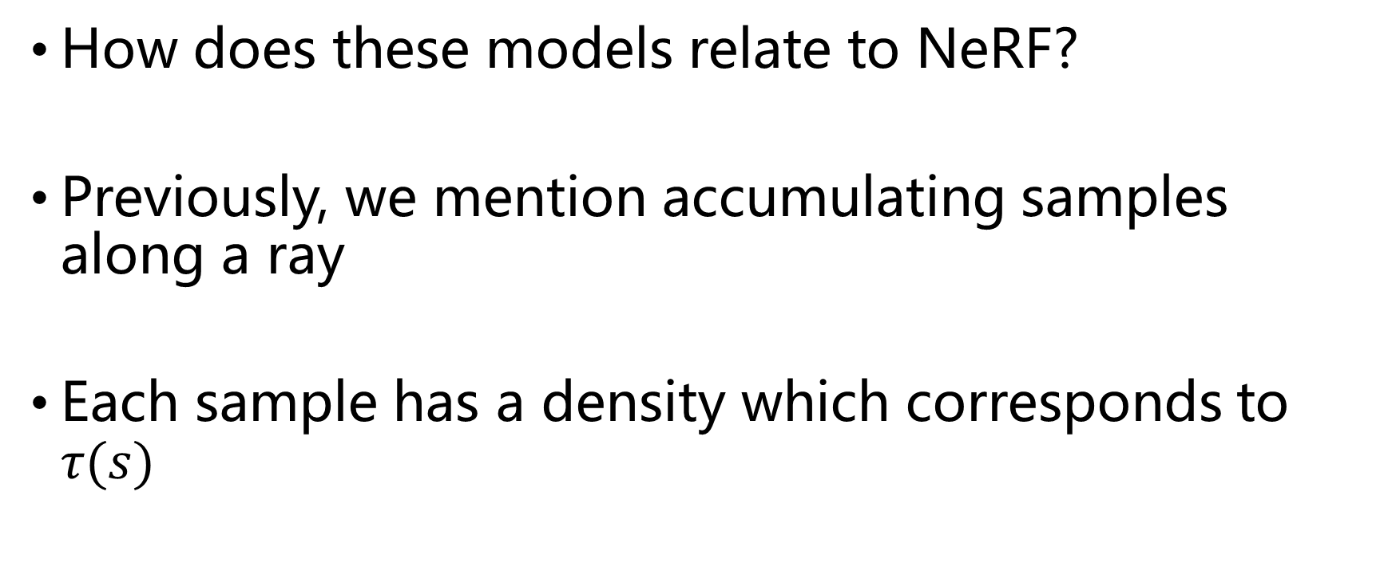
Direct Volume Rendering
How does these models relate to NeRF?
Previously, we mention accumulating samples along a ray
Each sample has a density which corresponds to $τ(s)$

Slide 48
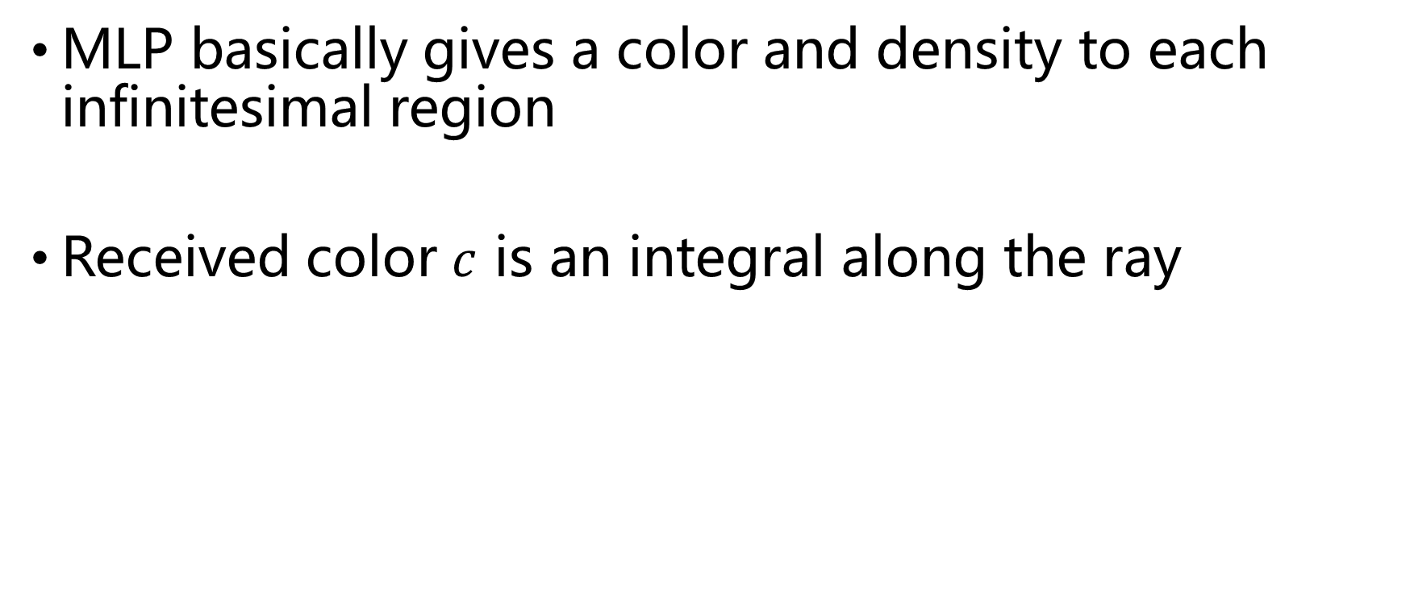
Direct Volume Rendering
MLP basically gives a color and density to each infinitesimal region
Received color $c$ is an integral along the ray

Slide 49
Direct Volume Rendering
Received color = integral along the ray

Slide 50
Direct Volume Rendering
In practice, we have to discretize the ray and apply numerical integral

Slide 51
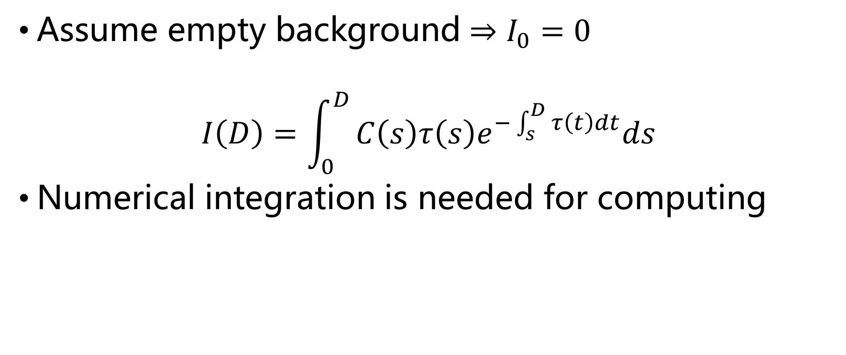
Numerical Volume Rendering
Assume empty background $⇒I_{0}=0$
$$I\left(D\right)=\int_{0}^{D}{C\left(s\right)τ\left(s\right)e^{−\int_{s}^{D}{τ\left(t\right)dt}}ds}$$
Numerical integration is needed for computing

Slide 52
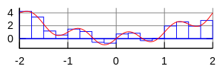
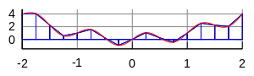
An introduction to numerical integration
Rectangle Rule
Trapziodal Rule

Slide 53
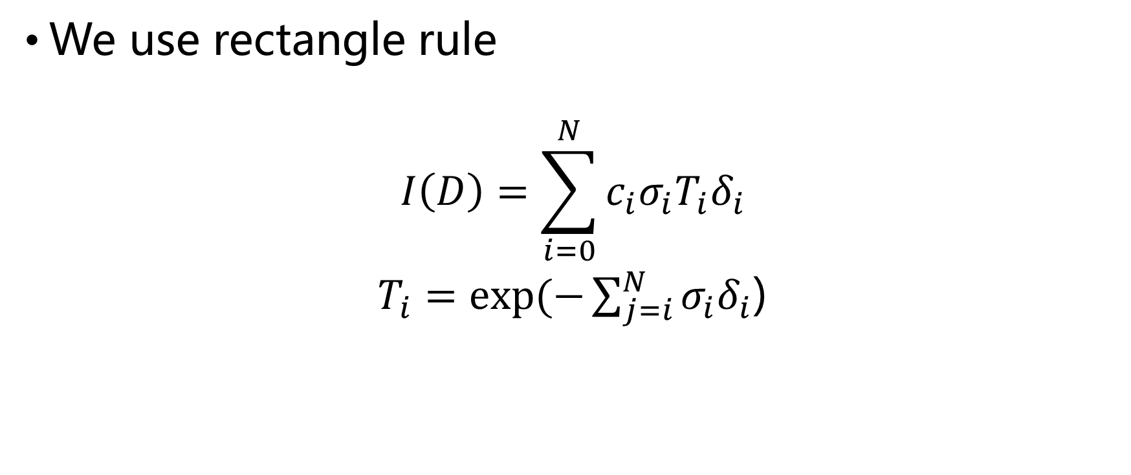
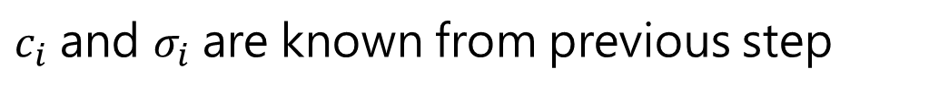
Numerical Volume Rendering
We use rectangle rule
$$I\left(D\right)=\sum_{i=0}^{N}{c_{i}σ_{i}T_{i}δ_{i}}$$
$T_{i}=exp⁡(−\sum_{j=i}^{N}{σ_{i}δ_{i}}$)
$c_{i}$ and $σ_{i}$ are known from previous step

Slide 54
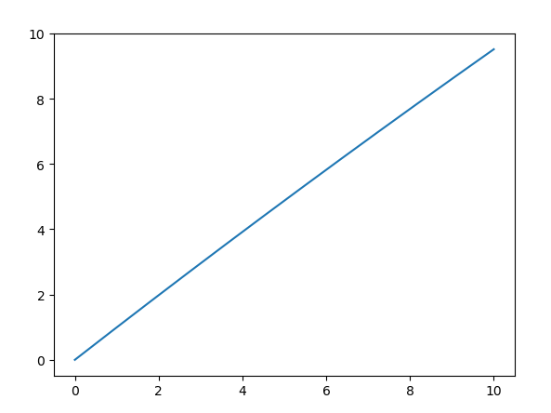
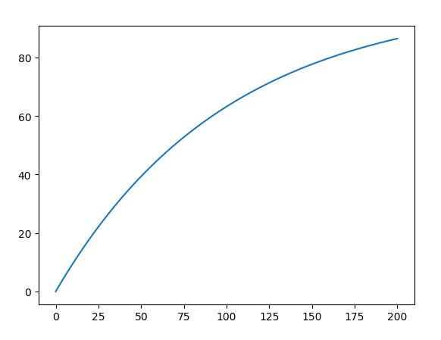
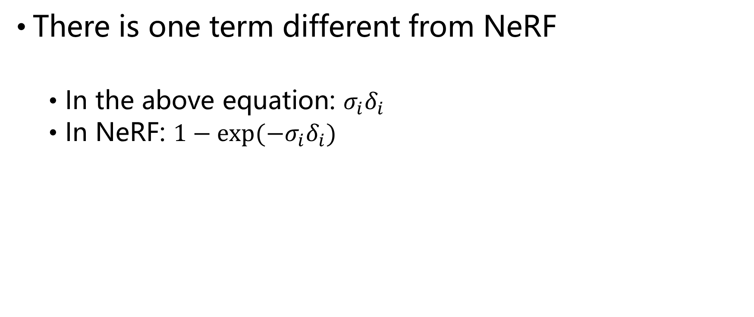
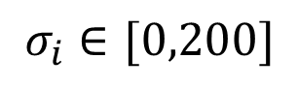
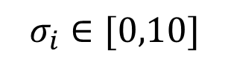
Numerical Volume Rendering
There is one term different from NeRF
In the above equation: $σ_{i}δ_{i}$
In NeRF: $1−exp⁡(−σ_{i}δ_{i})$
$$σ_{i}∈[0,10]$$
$$σ_{i}∈[0,200]$$

Slide 55
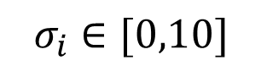
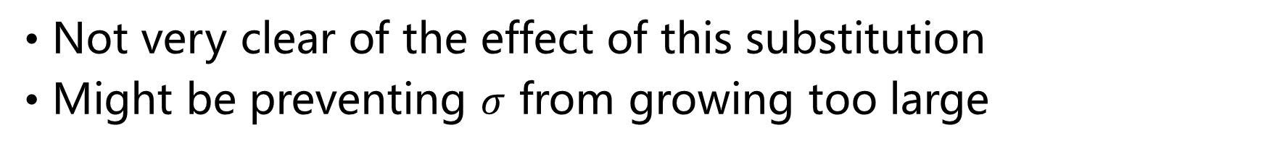
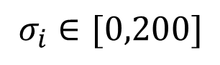
Numerical Volume Rendering
$$σ_{i}∈[0,10]$$
$$σ_{i}∈[0,200]$$
Not very clear of the effect of this substitution
Might be preventing $σ$ from growing too large

Slide 56
Volume Rendering
NeRF + Volume Rendering
Any questions?

Slide 57
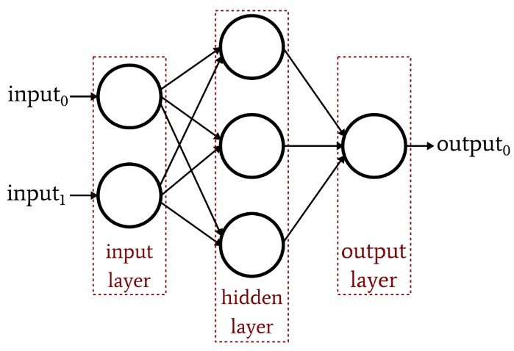
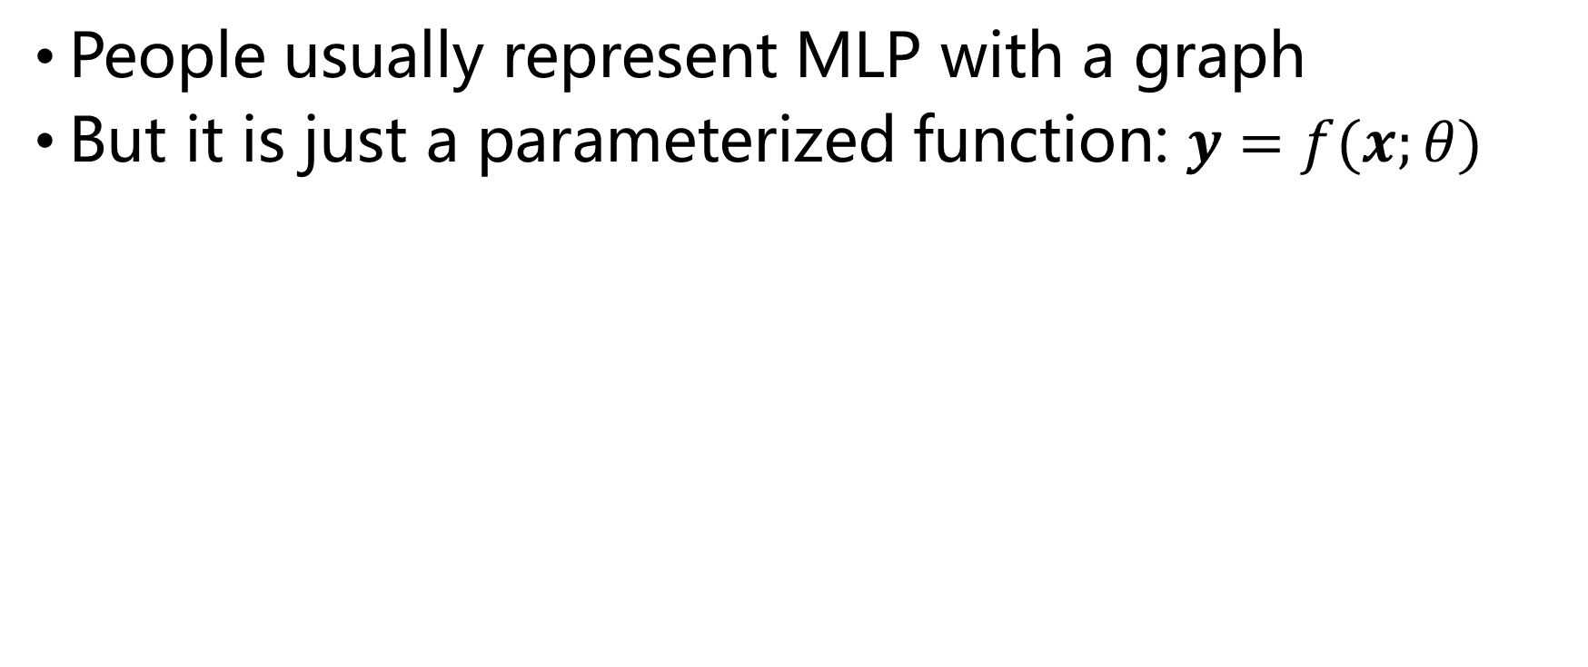
MLP (second part)
People usually represent MLP with a graph
But it is just a parameterized function: $y=f(x;θ)$

Slide 58
MLP (second part)
Parameters are weights and biases connecting consecutive layers
In this example, there are 9 weights and 4 biases

Slide 59
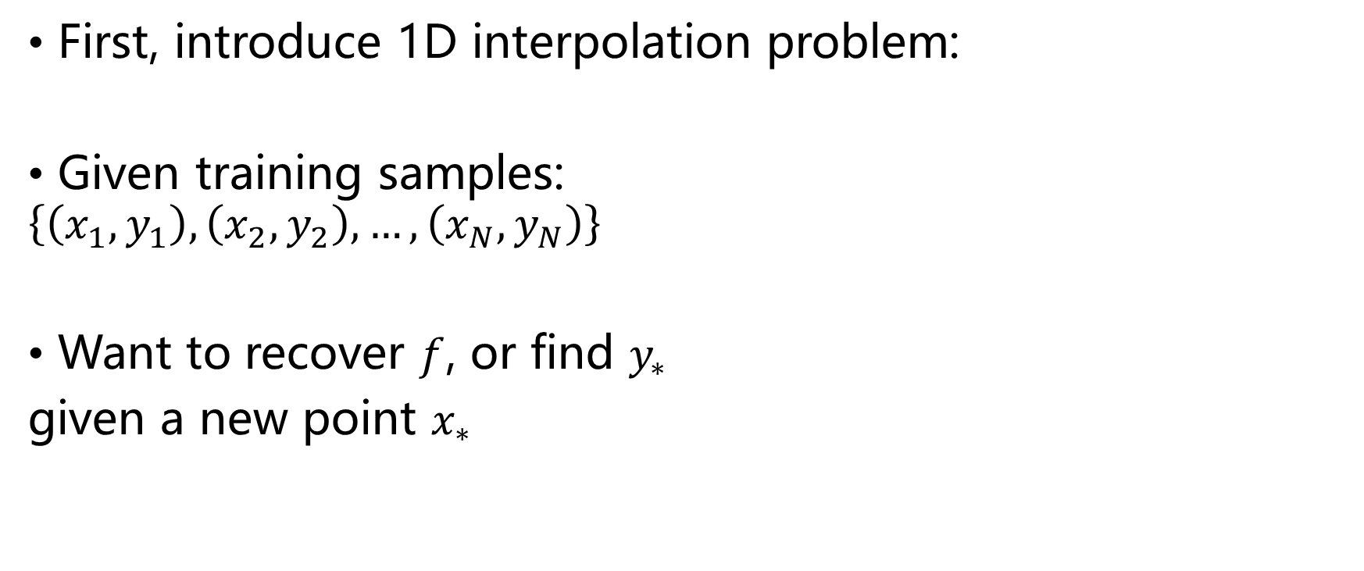
MLP (second part)
First, introduce 1D interpolation problem:
Given training samples:
$$\left\{\left(x_{1},y_{1}\right), \left(x_{2},y_{2}\right),…, \left(x_{N},y_{N}\right)\right\}$$
Want to recover $f$, or find $y_{∗}$
given a new point $x_{∗}$
samples
y
query
x

Slide 60

MLP (second part)
Realize that we can use a polynomial function to approximate
$$f\left(x\right)=w_{1}x+w_{2}x^{2}+w_{3}x^{3}+…+w_{n}x^{n}$$
But this function is not complete, it contains hyperparameters $n$ and parameters $w$

Slide 61

MLP (second part)
We select a appropriate number $n$ so that $f(x;w)$ has a complete form
We optimize parameters $w$ so that $f(x)$ is a good approximation to training samples
$$E=\sum_{i=0}^{N}{{\left[f\left(x_{i};w\right)−y_{i}\right]}^{2}}$$
f(x) is now fully determined and is ready for queries

Slide 62

MLP (second part)
A few things to note:
Why polynomial instead of rational function?
Why select $n=4$ instead of $n=8$?
Why optimize $w$ by minimizing Mean Squared Error (MSE)?

Slide 63

MLP (second part)
The answers to Q1 and Q2 are uniformly called model selection
The form of function $f$ is fully determined after model selection is done
People came up with good models that assembly neurons

Slide 64




MLP (second part)
That great model is called Multi-Layer Perceptron
It is an extension to the naive linear regression model $y=w^{T}x+b$
$$z_{1}=w_{1}x+b_{1}$$
$$x_{1}=non_linear(z_{1})$$
x
$$y=w_{3}x_{1}+w_{4}x_{2}+b_{3}$$
$$z_{2}=w_{2}x+b_{2}$$
$$x_{2}=non_linear(z_{2})$$

Slide 65

MLP (second part)
The general form of a single layer perceptron:
$$\left\{\begin{aligned}z^{1}=w_{1}x^{0}+b_{1} \\ x^{1}=φ\left(z_{1}\right) \\ y=w_{2}x^{1}+b_{2}\end{aligned}\right.$$
$x,y,z,b$ can be vectors and $w$ can be matrices

Slide 66

MLP (second part)
The general form of MLP:
$\left\{\begin{aligned}z^{1}=w_{1}x^{0}+b_{1} \\ x^{1}=φ\left(z_{1}\right) \\ z^{2}=w_{2}x^{1}+b_{2} \\ x^{2}=φ\left(z_{2}\right) \\ …… \\ y=w_{n}x^{n−1}+b_{n}\end{aligned}\right.$
(linear)
(non linear)
(linear)
(non linear)
……
(linear)

Slide 67
MLP (second part)
It is the non-linearity that distinguishes MLP from linear regression
As for model selection, we determine in advance the depth and width of the network
Next, why using MSE?

Slide 68

MLP (second part)
Instead of error, we use probability to measure the disagreement of samples to the model
Gaussian distribution is widely used
y
disagreement
$$f(x;w)$$
x

Slide 69

MLP (second part)
Given model $f(x)$ and a sample $(x_{i}, y_{i})$
The conditional probability of $y_{i}$ decreases as $(x_{i},y_{i})$ moves away from $f(x)$
Thus:
$$p\left(y_{i} | x_{i}\right)=𝒩(y_{i}|f\left(x_{i}\right), σ^{2})$$

Slide 70
MLP (second part)
It actually evaluates the correctness of your model.
If the probability is very high, it means your model has a big problem
Otherwise, it means your model agrees with the data

Slide 71

MLP (second part)
More than one samples:
$$p\left(y | x\right)=\prod_{i=1}^{N}{𝒩(y_{i}|f\left(x_{i}\right), σ^{2})}$$
We have assumed that $w$ is known

Slide 72

MLP (second part)
If $w$ is to be determined:
$$p\left(y | x,w\right)=\prod_{i=1}^{N}{𝒩(y_{i}|f\left(x_{i};w\right), σ^{2})}$$
Our goal is finding $w_{∗}$ so that $p(y|x,w)$ is maximized
This is commonly known as Maximum Likelihood (ML)

Slide 73

MLP (second part)
$\ln{p\left(y | x,w\right)}=\sum_{i=1}^{N}{𝒩\left(y_{i} | f\left(x_{i};w\right), σ^{2}\right)}$
$=\sum_{i=1}^{N}{ln\frac{1}{\sqrt{2πσ^{2}}}exp⁡(−\frac{{(y_{i}−f(x_{i};w))}^{2}}{2σ^{2}}})$
$=−\frac{1}{2σ^{2}}\sum_{i=1}^{N}{{\left[y_{i}−f\left(x_{i};w\right)\right]}^{2}}−\sum_{i=1}^{N}{ln}\sqrt{2πσ^{2}}$
We have proved that minimizing MSE is equivalent to maximizing $p(y|x)$

Slide 74

MLP (second part)
It is important to know:
MLP is just a function, a parameterized function
The determination of $w$ is done by maximizing the probability of $p(y|x)$. In other words, find $w$ so that $f(x;w)$ agree with data
The training of MLP is essentially a complicated version of gradient descent

Slide 75

MLP (second part)
In NeRF, we have an unknown function $g$ representing the radiance field
The authors adopted MLP to interpolate $g$
We train the network so that we get a best radiance field.
‘Best’ here means the probability of receiving observed images is maximized.

Slide 76
MLP (second part)
Up until now, any questions?

Slide 77

Feature Mapping
The third technology in NeRF is fundamental to its success.
Positional Encoding
$$φ\left(x\right)=\sum_{i=1}^{M}{\cos\left(a_{i}x\right)+sin⁡(b_{i}x)}$$
In machine learning literature, this is often called feature mapping. It’s effect is mapping $x$ onto a vector in feature space. The data should have a simpler pattern in that space.

Slide 78


Feature Mapping

Slide 79
Feature Mapping
Why does it work?
The authors have given an explanation in “Fourier Features Let Networks Learn High Frequency Functions in Low Dimensional Domains”
I will present another explanation briefly

Slide 80

Feature Mapping
Make two assumptions:
The width of MLP goes to infinity
Direct mapping of $g$ is given
We can derive the following equation:
$\left\{\begin{aligned}g\left(x^{∗}\right)=\sum_{i=1}^{N}{w_{i}g\left(x_{i}\right)=\sum_{i=1}^{N}{w_{i}y_{i}}} \\ \sum_{i=1}^{N}{w_{i}=1} \end{aligned}\right.$

Slide 81

Feature Mapping
$$g\left(x^{∗}\right)=\sum_{i=1}^{N}{w_{i}g\left(x_{i}\right)=\sum_{i=1}^{N}{w_{i}y_{i}}}$$
This equation shows that the function value at a new point $x^{∗}$ simply equals to weighted average of all data
By applying positional encoding, the weighing function shrinks

Slide 82



Feature Mapping
Visualize the effect by a 1D example
Training data spread across $[0,1]$. Test on $0.5$.
Without PE
With PE

Slide 83
Feature Mapping
Positional encoding shows obvious advantage
Though not perfect because of the oscillating effect
This implies PE retains high frequency signals
With PE

Slide 84
Q&A
Take any questions

